Slide 1

Decision Trees

Slide 2
Decision Trees
In this session we’ll learn about Decision Trees.
Decision Trees are versatile Machine Learning algorithms that can perform
Classification Tasks
Regression Tasks
And even multi-output tasks
They are very powerful algorithms, capable of fitting complex datasets. Also used in Random Forest (remember our project?)

Slide 3
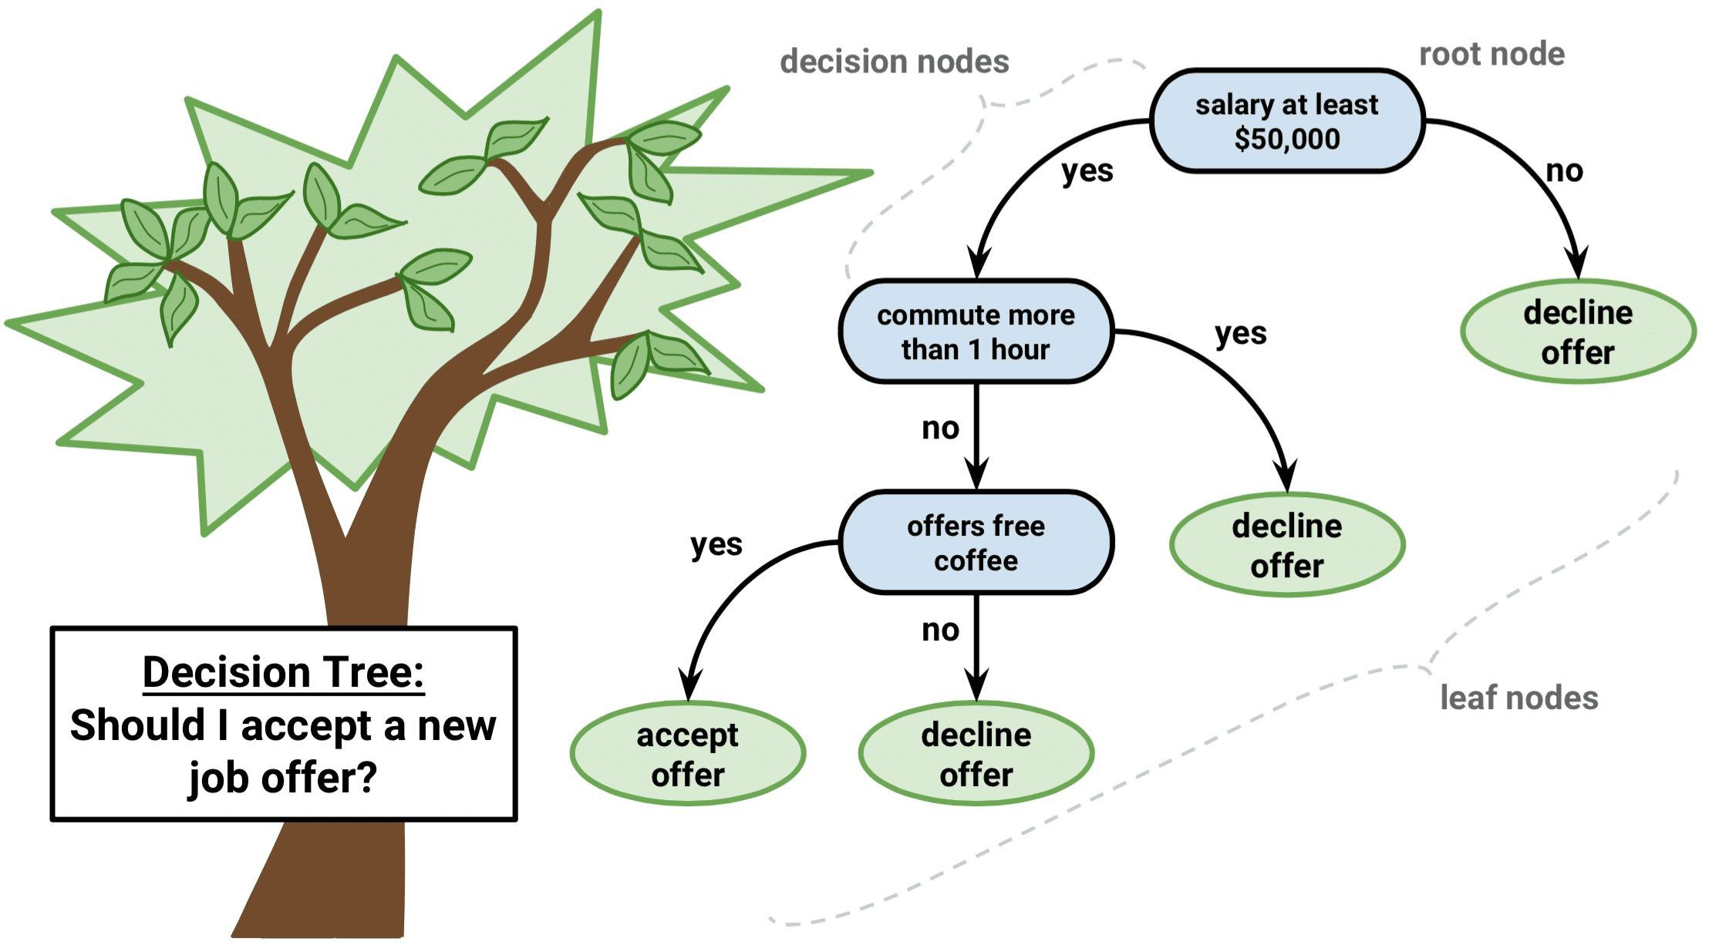
Decision Trees
Example of a Decision Tree

Slide 4
Decision Trees
What we’ll learn in this session ?
Working with Decision Trees
Train
Visualize
Make prediction with Decision tree
The CART training algorithm used by Scikit-Learn
How to regularize trees and use them for regression tasks
Regression with Decision Trees
Limitations of Decision Trees

Slide 5
Decision Trees
Training and Visualizing a Decision Tree
Let’s just build a Decision Tree and take a look at how it makes predictions
We’ll train a DecisionTreeClassifier using Scikit Learn on the famous Iris dataset.
And then we’ll see how it works.

Slide 6
Decision Trees
Iris Dataset - Training and Visualizing a Decision Tree
The iris dataset consists of 4 features namely :
Petal Length
Petal Width
Sepal Length
Sepal Width
There are three classes namely :
Iris Setosa
Iris Versicolor
Iris Virginica

Slide 7
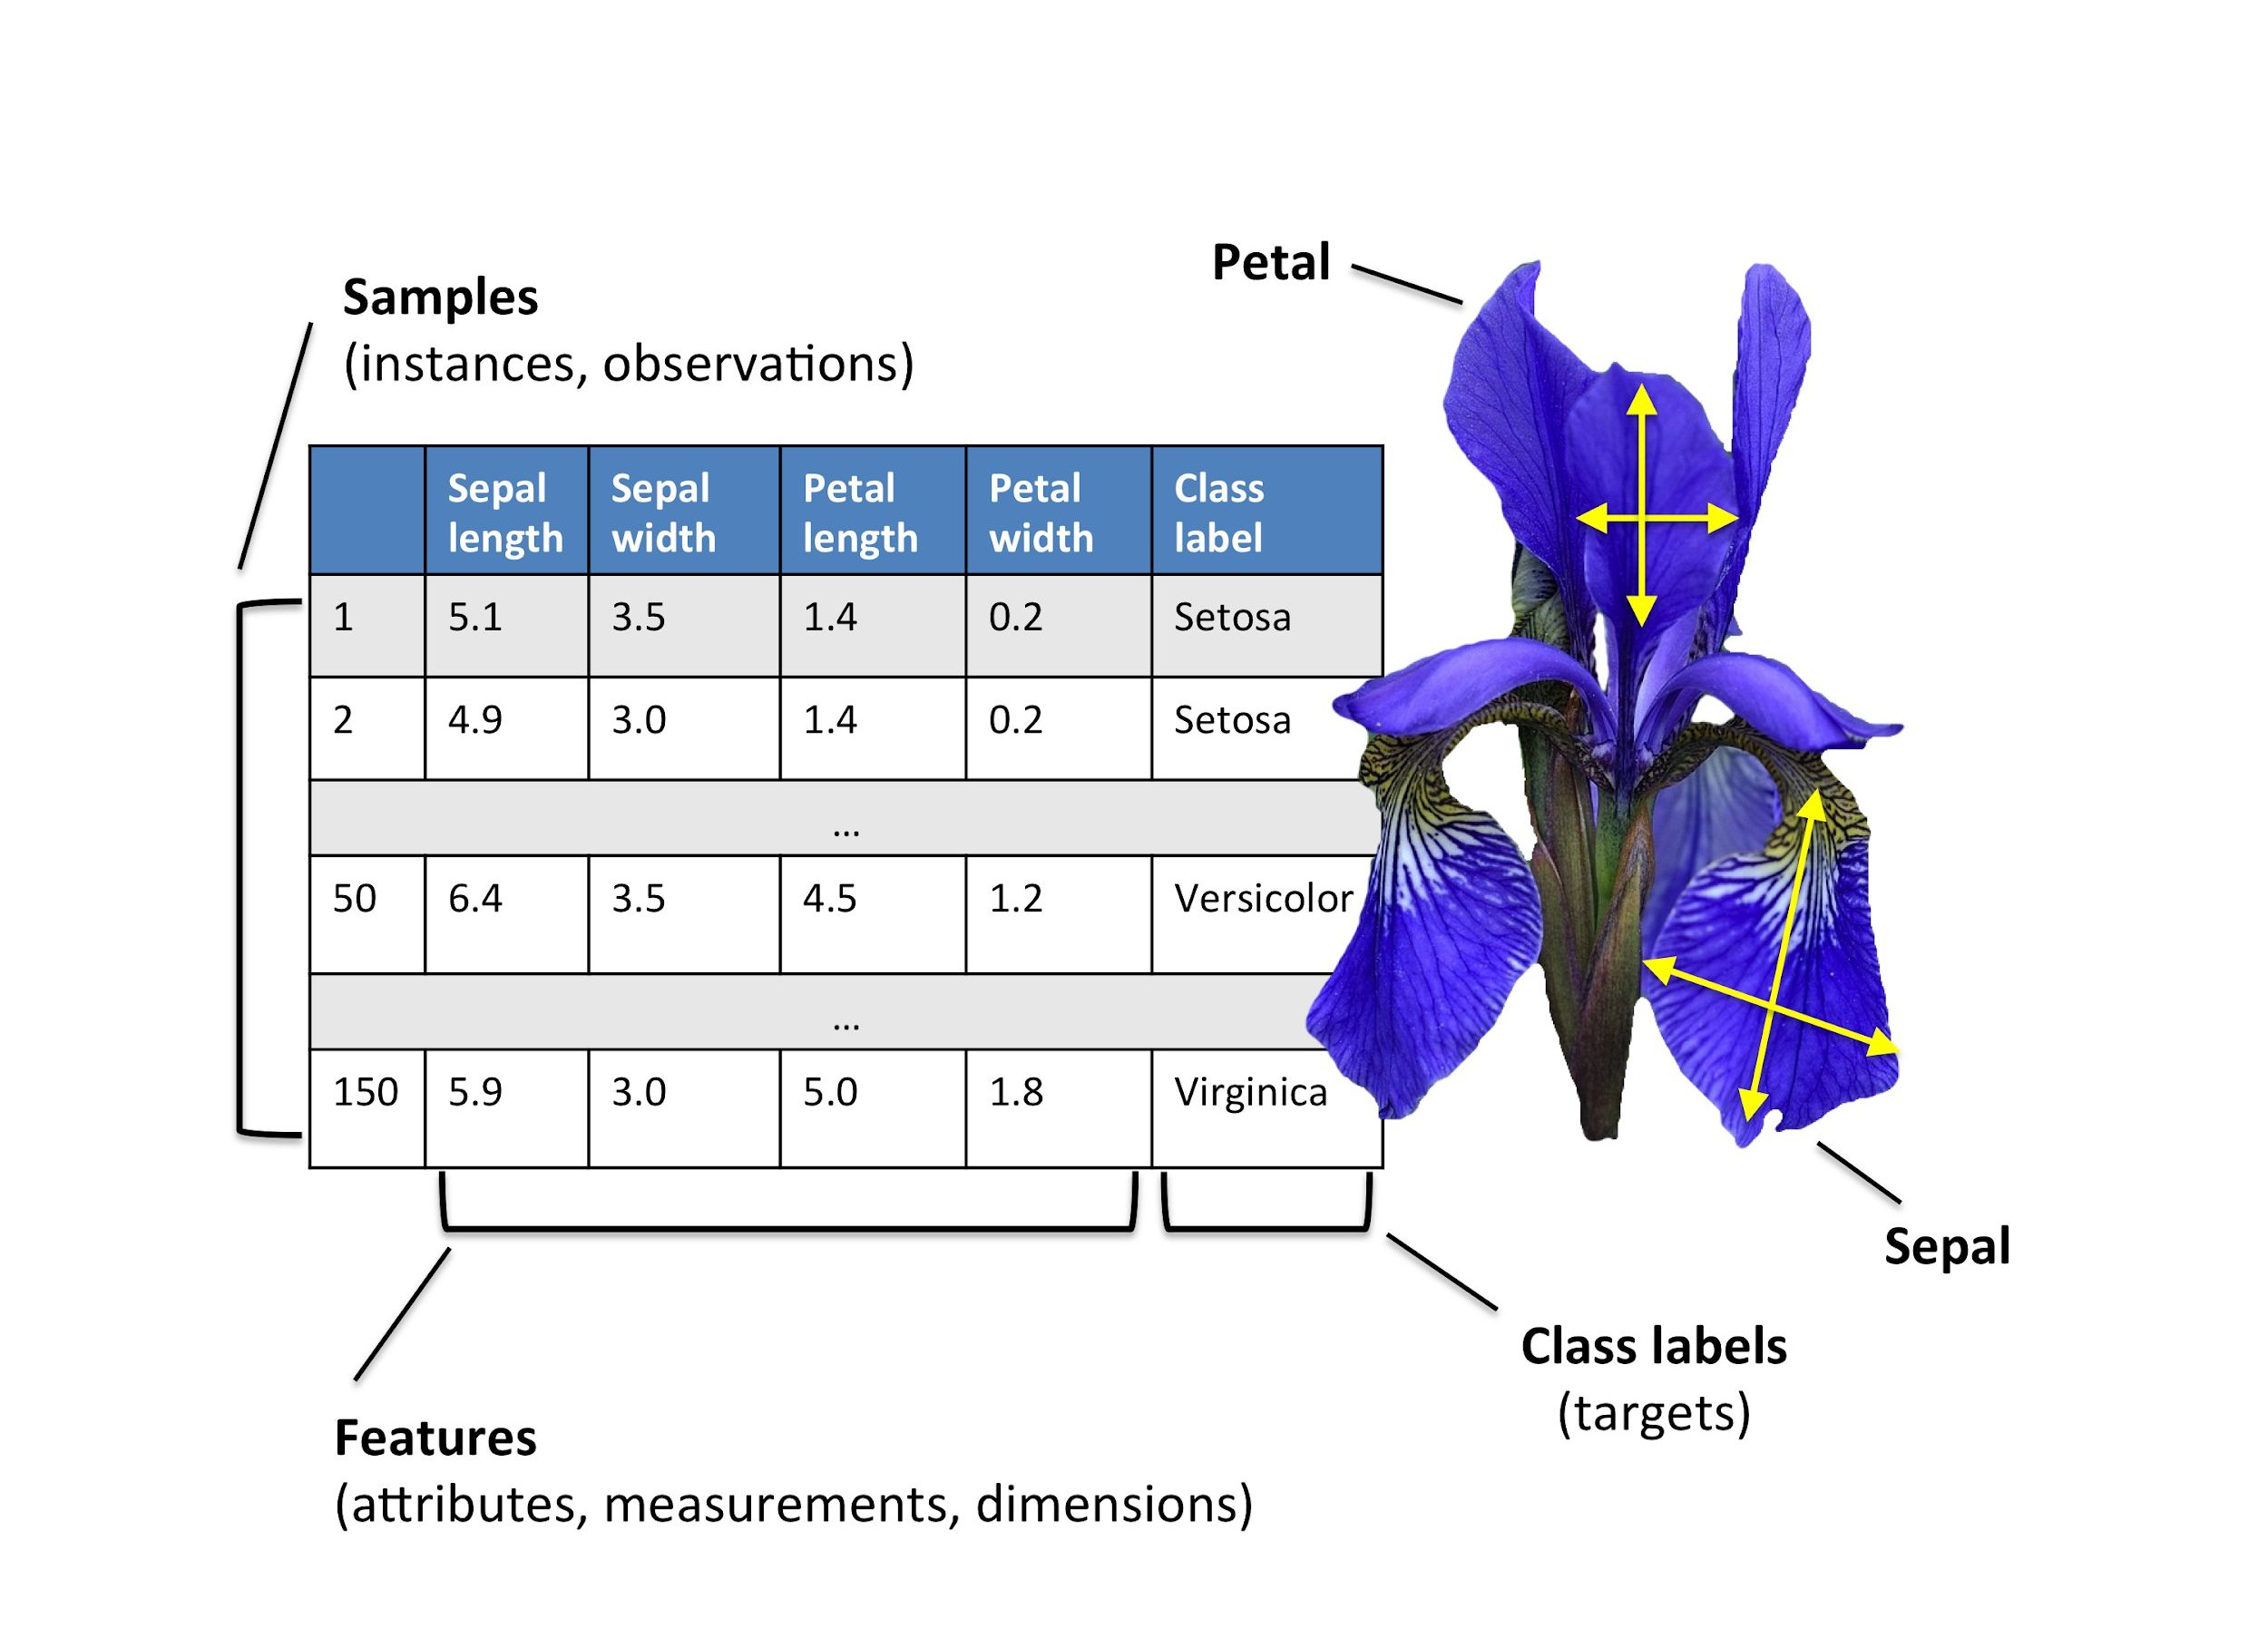
Decision Trees
Iris Dataset - Training and Visualizing a Decision Tree

Slide 8
Decision Trees
Training and Visualizing a Decision Tree
The iris dataset has 4 features petal length, petal width, sepal length and sepal width.
But here we’ll only use two features i.e. petal length and petal width.

Slide 9
Decision Trees
Training and Visualizing a Decision Tree
We will follow the following steps to train and visualize our decision tree
Load the Iris dataset using Scikit Learn
Select only the Petal length and Petal width features
Train our Decision Tree classifier on the Iris Dataset
Visualize our Decision Tree using export_graphviz()
export_graphviz() gives us a file in .dot format which we will convert to png using the dot command line tool

Slide 10
Decision Trees
Training and Visualizing a Decision Tree
1. Load the Iris dataset using Scikit Learn
>>> from sklearn.datasets import load_iris
>>> iris = load_iris()
Run it in jupyter notebook

Slide 11
Decision Trees
Training and Visualizing a Decision Tree
2. Select only the Petal length and Petal width features
>>> | X | = | iris.data[:, | 2:] | # | petal | length | and | width
>>> | y | = | iris.target
Run it in jupyter notebook

Slide 12
Decision Trees
Training and Visualizing a Decision Tree
3. Train our Decision Tree classifier on the Iris Dataset
>>> from sklearn.tree import DecisionTreeClassifier
>>> tree_clf = DecisionTreeClassifier(max_depth=2)
>>> tree_clf.fit(X, y)
Run it in jupyter notebook

Slide 13
Decision Trees
Training and Visualizing a Decision Tree
4. Visualize our Decision Tree using export_graphviz()
We can visualize the trained decision tree using the export_graphviz()
method.
>>> from sklearn.tree import export_graphviz
>>> export_graphviz( tree_clf, out_file=image_path("iris_tree.dot"), feature_names=iris.feature_names[2:], class_names=iris.target_names, rounded=True, filled=True )

Slide 14
Decision Trees
Training and Visualizing a Decision Tree
5. Converting to Png file
Then you can convert this .dot file to a variety of formats such as PDF or PNG using the dot command- line tool from the graphviz package.
This command line converts the .dot file to a .png image file:
>>> dot -Tpng iris_tree.dot -o iris_tree.png
Run it in the console

Slide 15
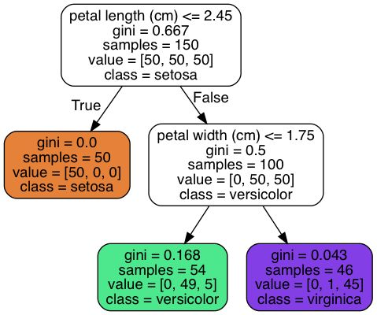
Decision Trees
Training and Visualizing a Decision Tree

Slide 16
Decision Trees
Understanding the Decision Tree
A node’s value attribute tells you how many training instances of each class this node applies to for example, the bottom-right node applies to 0 Iris-Setosa, 1 Iris- Versicolor, and 45
Iris-Virginica.

Slide 17
Decision Trees
Understanding the Decision Tree
A node’s gini attribute measures its impurity: a node is “pure” (gini=0) if all training instances it applies to belong to the same class.
For example, since the depth-1 left node applies only to
Iris-Setosa training instances, it is pure and its gini score is 0.

Slide 18
Decision Trees
Making Predictions
To make a prediction the decision classifier follows these steps :
Start at the root node (depth 0, at the top), this node asks whether the flower’s petal length is smaller than or equal to 2.45 cm:

Slide 19
Decision Trees
Making Predictions
If it is, then you move down to the root’s left child node (depth 1, left). In this case it is a leaf node hence the flower is predicted as setosa.

Slide 20
Decision Trees
Making Predictions
If it is not, then you move down to the root’s right child node (depth 1, right), since it is not a leaf node it asks further questions as, is the petal width smaller than or equal to 1.75 cm?

Slide 21
Decision Trees
Making Predictions
If it is, then your flower is most likely an Iris- Versicolor (depth 2, left).
If it is not, If not, it is likely an Iris-Virginica (depth 2, right).

Slide 22
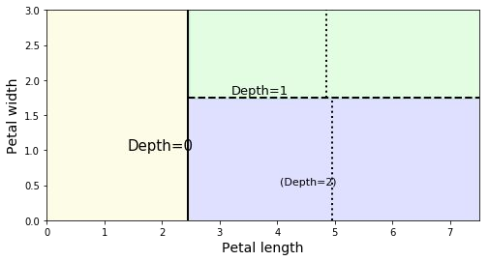

Decision Trees
Decision Tree’s decision boundaries.
Boundary made at depth 0. Petal length <= 2.45

Slide 23

Decision Trees
Decision Tree’s decision boundaries.
Boundary made at depth 1. Petal width <= 1.75

Slide 24

Decision Trees
Decision Tree’s decision boundaries.
This would have been the decision boundary to divide the tree further
i.e. if max_depth was set to 3

Slide 25
Decision Trees
How is Gini Impurity Calculated?
A node’s gini attribute measures its impurity: a node is
“Pure” (gini=0) if all training instances it applies to belong to the same class.
A Gini coefficient of 1 expresses maximal inequality among the training samples.

Slide 26
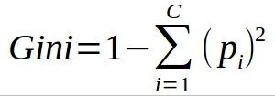
Decision Trees
How is Gini Impurity Calculated?
The formula for finding the gini impurity score of a particular level is :
Here p_{i} is the ratio of class i in the node whose gini index is being calculated. There are total of c classes.

Slide 27
Decision Trees
How is Gini Impurity Calculated?
For example, since the depth-1 left node applies only to
Iris-Setosa training instances, it is pure and its gini score is 0.

Slide 28
Decision Trees
How is Gini Impurity Calculated?
In the our example the depth-2 left node has a gini score equal to 1 – (0/54)² – (49/54)² – (5/54)² ≈
0.168

Slide 29
Decision Trees
Model Interpretation : White Box versus Black Box
A White Box Model is :
Fairly intuitive
Their decisions are easy to interpret
Eg. Decision Trees

Slide 30
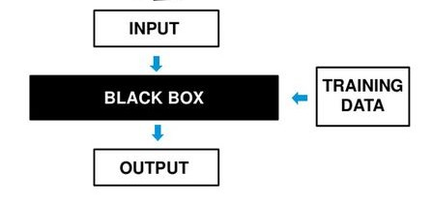
Decision Trees
Model Interpretation : White Box versus Black Box
A Black Box Model is :
They make great predictions
Easy to check the calculations that were performed to make these predictions

Slide 31
Decision Trees
Model Interpretation : White Box versus Black Box
A Black Box Model is :
It is usually hard to explain in simple terms why the predictions were made
Eg. Random Forests , Neural networks

Slide 32
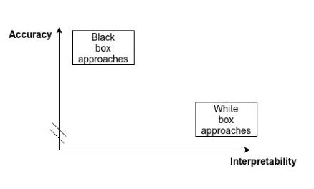
Decision Trees
Model Interpretation : White Box versus Black Box

Slide 33
Decision Trees
Estimating Class Probabilities
A Decision Tree can also estimate the probability that an instance belongs to a particular class k.
To do this it follows the following steps:
First it traverses the tree to find the leaf node for this instance
Then it returns the ratio of training instances of class k in this node.

Slide 34
Decision Trees
Estimating Class Probabilities
Suppose you have found a flower whose petals are
5 cm long and
1.5 cm wide

Slide 35
Decision Trees
Estimating Class Probabilities
It first asks the question whether petal length <= 2.45. Since the condition is false it will go to the right subset

Slide 36
Decision Trees
Estimating Class Probabilities
It will then ask if petal width <=
1.75. Since the condition is true it will go the left subset.

Slide 37
Decision Trees
Estimating Class Probabilities
Decision Tree should output the following probabilities:
0% for Iris-Setosa (0/54)
90.7% for Iris-Versicolor (49/54)
9.3% for Iris- Virginica (5/54)

Slide 38
Decision Trees
Estimating Class Probabilities
If we ask it to predict the class, it should output Iris-Versicolor (class 1) since it has the highest probability.
Let’s verify it:
>>> tree_clf.predict_proba([[5, 1.5]])
array([[ | 0. | , | 0.90740741, | 0.09259259]])
>>> tree_clf.predict([[5, |  |  |  | 1.5]])
array([1]) Run it in |  |  |  | jupyter | notebook

Slide 39
Decision Trees
The CART Training Algorithm
Scikit-Learn uses the Classification And Regression Tree (CART) algorithm to train Decision Trees.
The idea is really quite simple:
The algorithm first splits the training set in two subsets using a single feature k and a threshold tk

Slide 40

Decision Trees
The CART Training Algorithm
How does it choose k and tk???
It searches for the pair (k, tk) that produces the purest subsets (weighted by
their size)
Splitting on the basis of feature k and a threshold value of tk
Purest Subset
Purest Subset

Slide 41
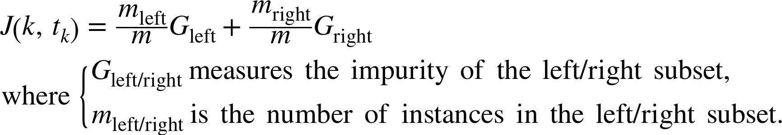
Decision Trees
The CART Training Algorithm
The cost function that the algorithm tries to minimize is given by the equation :

Slide 42
Decision Trees
The CART Training Algorithm
Once it has successfully split the training set in two, it splits the subsets using the same logic, then the sub- subsets and so on, recursively
It stops recursion once it reaches the maximum depth (defined by the max_depth hyperparameter), or if it cannot find a split that will reduce impurity.

Slide 43

Decision Trees
Important points on the CART Training Algorithm
It is a greedy algorithm as it greedily searches for an optimum split at the top level
Then repeats the process at each level.
Splitting on the basis of feature k and a threshold value of tk
Purest Subset
Purest Subset

Slide 44
Decision Trees
Important points on the CART Training Algorithm
It does not check whether or not the split will lead to the lowest possible impurity several levels down.
A greedy algorithm often produces a reasonably good solution, but it is not guaranteed to be the optimal solution

Slide 45
Decision Trees
Computational Complexity of Decision Trees
Complexity of Prediction :
Making predictions requires traversing the Decision Tree from the root to a leaf.
Decision Trees are generally approximately balanced, so traversing the Decision Tree requires going through roughly O(log₂(m)) nodes, where m is total number of training instances.

Slide 46
Decision Trees
Computational Complexity of Decision Trees
Complexity of Prediction :
Since each node only requires checking the value of one feature, the overall prediction complexity is just O(log₂(m))
One feature checked i.e. petal length
One feature checked i.e. petal width

Slide 47
Decision Trees
Computational Complexity of Decision Trees
Complexity of Prediction :
Hence, the complexity of prediction is independent of the number of features.
So predictions are very fast, even when dealing with large training sets.

Slide 48
Decision Trees
Computational Complexity of Decision Trees
Complexity of Training :
The training algorithm compares all features (or less if max_features is set) on all samples at each node.
This results in a training complexity of O(n × m log(m)), where n is the number of features, we have to compare all the n features at each of the m nodes.

Slide 49
Decision Trees
Computational Complexity of Decision Trees
Complexity of Training :
For small training sets (less than a few thousand instances),
Scikit-Learn can speed up training by presorting the data (set presort=True), but this slows down training considerably for larger training sets.

Slide 50
Decision Trees
Which measure to use ? Gini Impurity or Entropy?
By default, the Gini impurity measure is used, but you can select the entropy impurity measure instead by setting the criterion hyperparameter to "entropy".
Entropy measures the degree of randomness

Slide 51
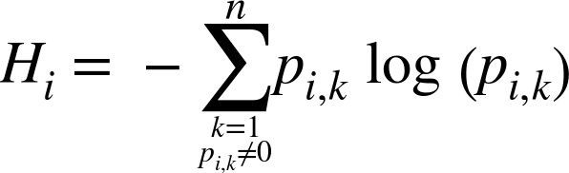
Decision Trees
Which measure to use ? Gini Impurity or Entropy?
The formula for measuring entropy is

Slide 52
Decision Trees
Which measure to use ? Gini Impurity or Entropy?
The entropy for the depth-2 left node is
≈ 0.31

Slide 53
Decision Trees
Which measure to use ? Gini Impurity or Entropy?
The truth is, most of the time it does not make a big difference: they lead to similar trees.
Gini impurity is slightly faster to compute, so it is a good default.
However, Gini impurity tends to isolate the most frequent class in its own branch of the tree
While entropy tends to produce slightly more balanced trees.

Slide 54
Decision Trees
Regularization Hyperparameter
If left unconstrained, the tree structure will adapt itself to the training data, fitting it very closely, and most likely overfitting it.
To avoid overfitting the training data, you need to restrict the Decision Tree’s freedom during training.

Slide 55
Decision Trees
Regularization Hyperparameter
Putting restriction on the freedom of the model during training is called regularization. The regularization hyperparameters depend on the algorithm used, but generally you can at least restrict the maximum depth of the Decision Tree.

Slide 56
Decision Trees
Parametric and Non-parametric models
Models like Decision Tree models are often called nonparametric model because the number of parameters is not determined prior to training, so the model structure is free to stick closely to the data.
In contrast, a parametric model such as a linear model has a predetermined number of parameters, so its degree of freedom is limited, reducing the risk of overfitting but increasing the risk of underfitting.

Slide 57
Decision Trees
Regularization parameters for DecisionTreeClassifier class
max_depth → restricts the maximum depth of the Decision Tree
min_samples_split → the minimum number of samples a node must have before it can be split
min_samples_leaf → the minimum number of samples a leaf node must have

Slide 58
Decision Trees
Regularization parameters for DecisionTreeClassifier class
min_weight_fraction_leaf → same as min_samples_leaf but expressed as a fraction of the total number of weighted instances
max_leaf_nodes → maximum number of leaf nodes
max_features → maximum number of features that are evaluated for splitting at each node
Increasing min_* hyperparameters or reducing max_* hyperparameters will regularize the model.

Slide 59
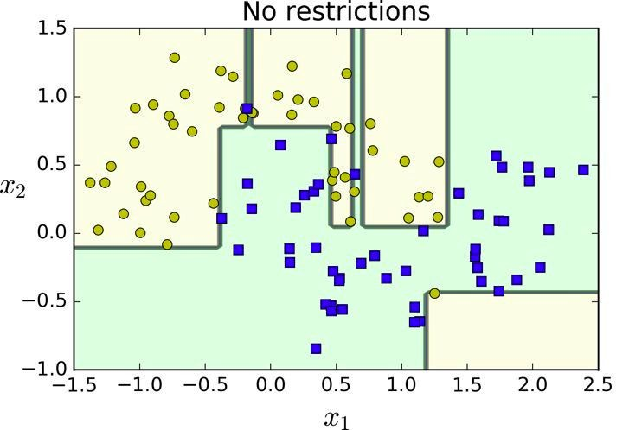
Decision Trees
Regularization parameters for DecisionTreeClassifier class
The above Decision Tree is trained with the default hyperparameters i.e., no restrictions. This model is Overfitting the data.

Slide 60
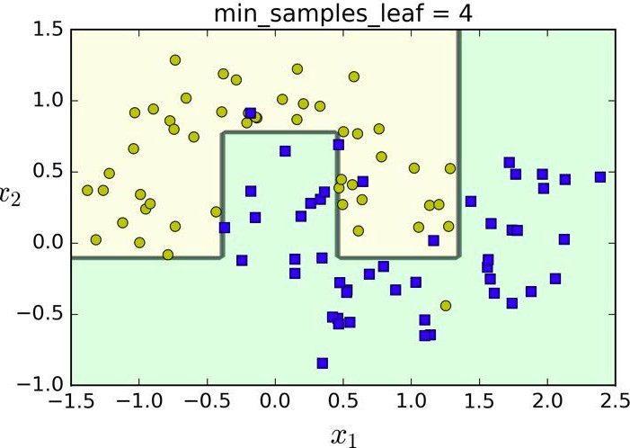
Decision Trees
Regularization parameters for DecisionTreeClassifier class
The above Decision Tree is trained with min_samples_leaf=4. This model will probably generalize better.

Slide 61
Decision Trees
Regression with Decision Trees
Decision Trees are also capable of performing regression tasks. Let’s build a regression tree using Scikit- Learn’s DecisionTreeRegressor class, training it on a noisy quadratic dataset with max_depth=2

Slide 62
Decision Trees
Regression with Decision Trees
>>> from sklearn.tree import DecisionTreeRegressor
>>> tree_reg = DecisionTreeRegressor(max_depth=2) tree_reg.fit(X, y)
Run it on Notebook

Slide 63
Decision Trees
Regression with Decision Trees
The main difference is that instead of predicting a class in each node, it predicts a value.

Slide 64
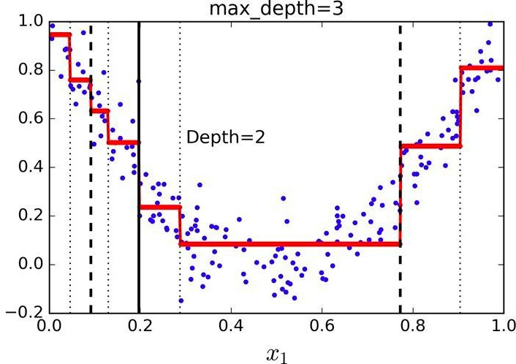
Decision Trees
Regression with Decision Trees
Notice how the predicted value for each region is always the average target value of the instances in that region.

Slide 65
Decision Trees
Regression with Decision Trees
The CART algorithm works the same way except instead of trying to split the training set in a way that minimizes impurity, it now tries to split the training set in a way that minimizes the MSE.

Slide 66
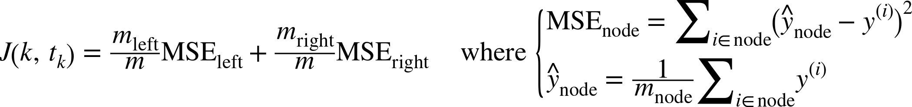
Decision Trees
Regression with Decision Trees
The formula for cost function for regression is -

Slide 67
Decision Trees
Regression with Decision Trees
Just like for classification tasks, Decision Trees are prone to overfitting when dealing with regression tasks.
Without any regularization the model may overfit the data.

Slide 68
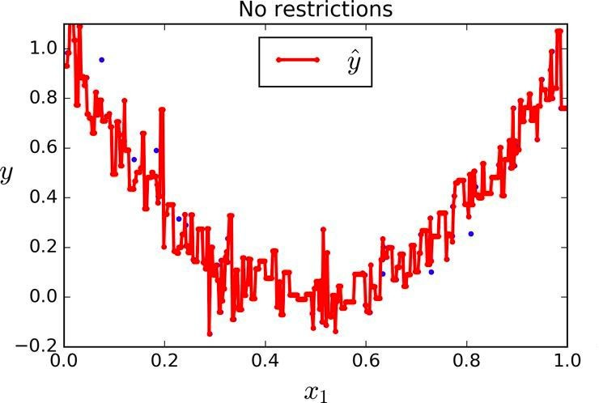
Decision Trees
Regression with Decision Trees
Without any regularization i.e., using the default hyperparameters, you get the above model.
It is obviously overfitting the training set very badly.

Slide 69
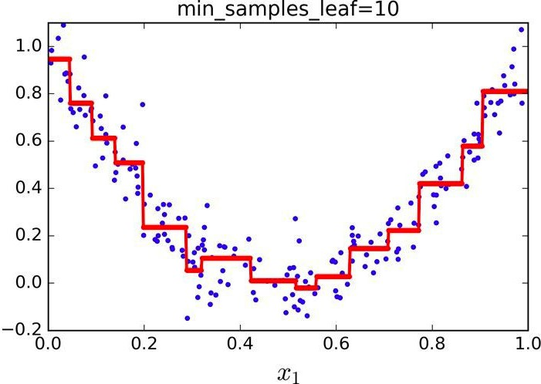
Decision Trees
Regression with Decision Trees
Just setting min_samples_leaf=10 results in a much more reasonable model, represented by the above figure.

Slide 70
Decision Trees
Demerits of Decision Trees
Decision Trees love orthogonal decision boundaries (all splits are perpendicular to an axis)
This makes them sensitive to training set rotation.
They are very sensitive to small variations in the training data.

Slide 71
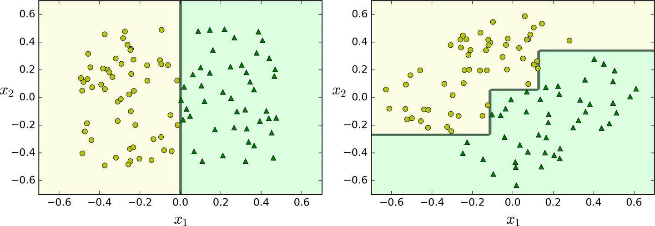
Decision Trees
Demerits of Decision Trees
Above figure shows a simple linearly separable dataset: on the left, a Decision Tree can split it easily, while on the right, after the dataset is rotated by 45°, the decision boundary looks unnecessarily convoluted.

Slide 72
Decision Trees
Demerits of Decision Trees
Although both Decision Trees fit the training set perfectly, it is very likely that the model on the right will not generalize well.

